Slide 1
Needle-Haystack

Slide 2
Big or small haystacks?
Different pore sizes capture different material
Effective pore size decreases if filter more water
The current thought is: capturing more DNA is better for rare targets
But capturing more DNA also means capturing more inhibitors

Slide 3
Crash course in PCR and inhibition
Inhibition – PCR not performing optimally, estimates of concentration (or proportion??) are not correct
Test for inhibition with qPCR
qPCR – gives you Cts
Use IPC to test for inhibition
NOT inhibited if:
Ct_{IPC} in the sample + IPC = Ct_{IPC} in NTC + IPC
Inhibited if:
Ct_{IPC} in the sample + IPC > (or amplified later than) Ct_{IPC} in NTC + IPC
If inhibited:
Dilute sample
Clean sample

Slide 4
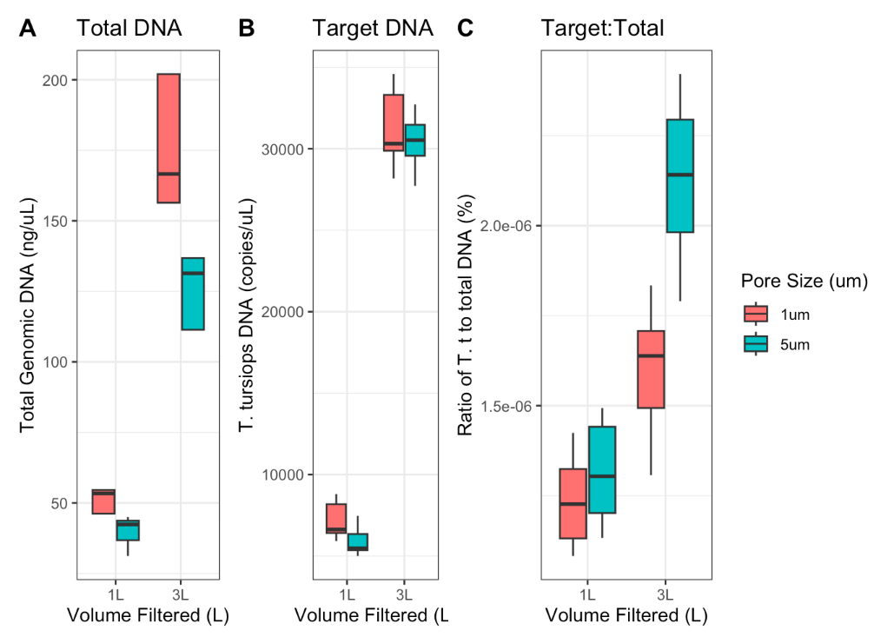
Module 1 data recap
Filter and pore size
1 micon, 1 liter
1 micron, 3 liters
5 micron, 1 liter
5 micron 3 liters
Ratio of target to total doesn't scale -- > effective pore size

Slide 5
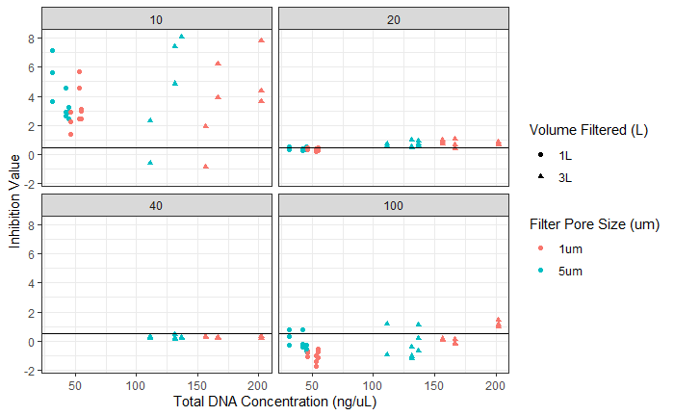
Module 1 data recap
Filter and pore size
1 micon, 1 liter
1 micron, 3 liters
5 micron, 1 liter
5 micron 3 liters
Have to dilute sample down to be not inhibited

Slide 6
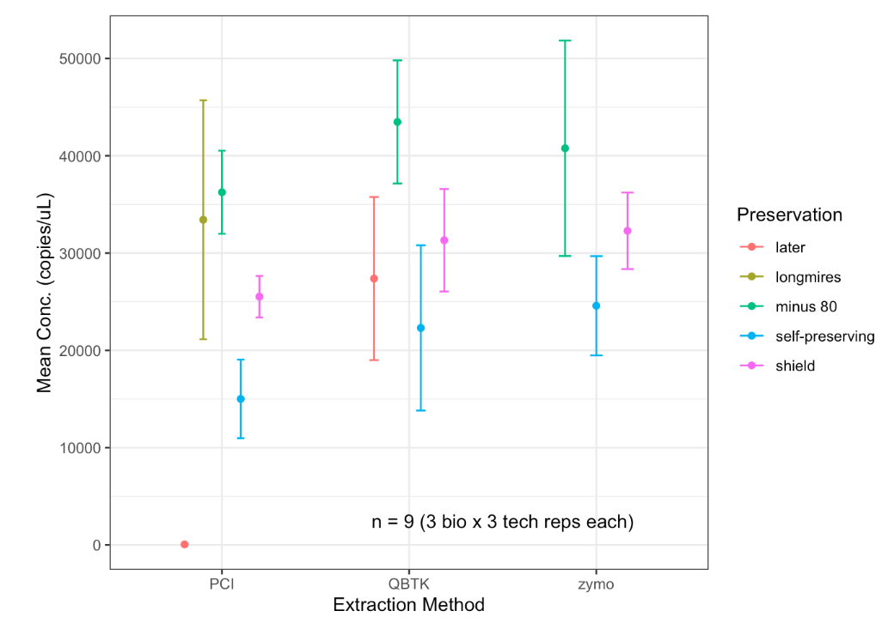
Module 1 data recap
Preservation and extraction method
Preservation
-80
Self preserving
Longmires
RNAlater
DNA/RNA Shield
Extraction
Phenol chloroform
Qiagen Blood and Tissue Kit
Zymo Mini Prep Kit
Variation from bio reps, but on same log scale (except for few combos)

Slide 7
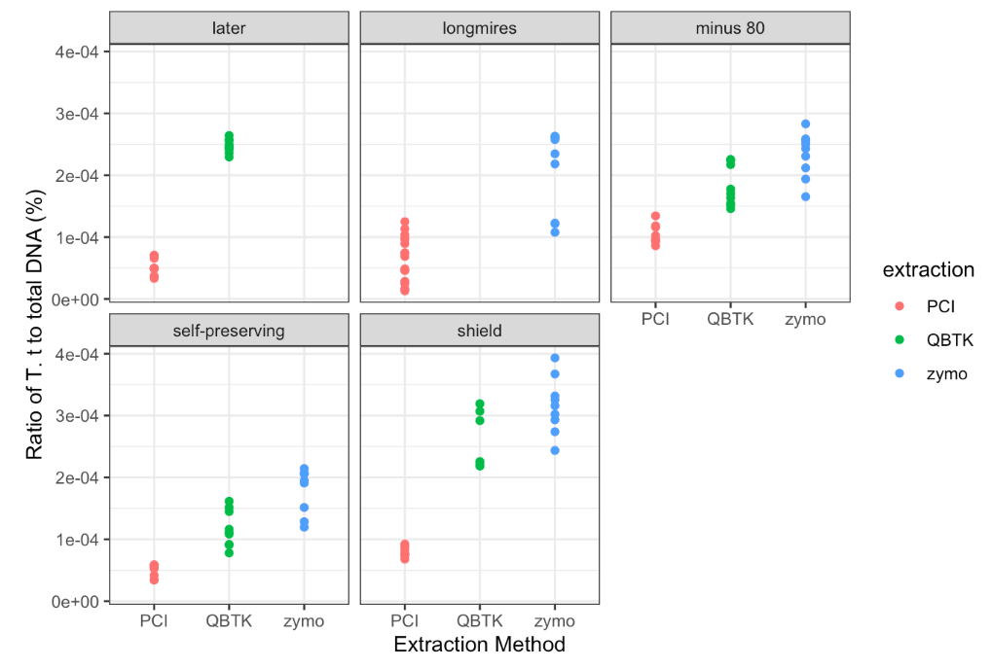
Module 1 data recap
Preservation and extraction method
Preservation
-80
Self preserving
Longmires
RNAlater
DNA/RNA Shield
Extraction
Phenol chloroform
Qiagen Blood and Tissue Kit
Zymo Mini Prep Kit
Shield-Zymo best ratio of target to total DNA
Longmires/later-PCI worst ratio of target to total DNA

Slide 8
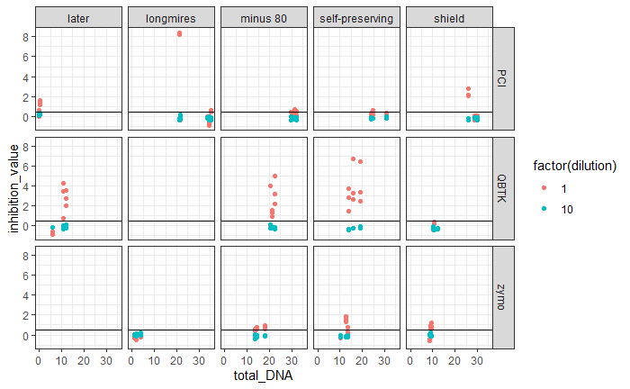
Module 1 data recap
Preservation and extraction method
Preservation
-80
Self preserving
Longmires
RNAlater
DNA/RNA Shield
Extraction
Phenol chloroform
Qiagen Blood and Tissue Kit
Zymo Mini Prep Kit
Inhibition varies by extraction method

Slide 9
Next…
Look at range of dilutions for samples of varying target
Within that dilution, the sample goes from inhibited to not inhibited
Investigate:
qPCR – concentration estimates
ddPCR – concentration estimates
Metabarcoding – proportion estimates

Slide 10
qPCR expectations – high target
Not cleaned
Cleaned to remove inhibitors
6
5
4
3
2
1
0
6
5
4
3
2
1
0
Log copies of dolphin DNA
Log copies of dolphin DNA
1 1E-1 1E-2 1E-3 1E-4 1E-5 1E-6
Dilution
1 1E-1 1E-2 1E-3 1E-4 1E-5 1E-6
Dilution

Slide 11
ddPCR expectations – high target
Not cleaned
Cleaned to remove inhibitors
6
5
4
3
2
1
0
6
5
4
3
2
1
0
Log copies of dolphin DNA
Log copies of dolphin DNA
1 1E-1 1E-2 1E-3 1E-4 1E-5 1E-6
Dilution
1 1E-1 1E-2 1E-3 1E-4 1E-5 1E-6
Dilution

Slide 12
Metabarcoding expectations?? – high target
Not cleaned
Cleaned to remove inhibitors
6
5
4
3
2
1
0
6
5
4
3
2
1
0
Log copies of dolphin DNA
Log copies of dolphin DNA
1 1E-1 1E-2 1E-3 1E-4 1E-5 1E-6
Dilution
1 1E-1 1E-2 1E-3 1E-4 1E-5 1E-6
Dilution

Slide 13
Metabarcoding expectations?? – high target
Not cleaned
Cleaned to remove inhibitors
6
5
4
3
2
1
0
6
5
4
3
2
1
0
Log copies of dolphin DNA
Log copies of dolphin DNA
1 1E-1 1E-2 1E-3 1E-4 1E-5 1E-6
Dilution
1 1E-1 1E-2 1E-3 1E-4 1E-5 1E-6
Dilution

Slide 14
Metabarcoding expectations?? – high target
Not cleaned
Cleaned to remove inhibitors
6
5
4
3
2
1
0
6
5
4
3
2
1
0
Log copies of dolphin DNA
Log copies of dolphin DNA
1 1E-1 1E-2 1E-3 1E-4 1E-5 1E-6
Dilution
1 1E-1 1E-2 1E-3 1E-4 1E-5 1E-6
Dilution

Slide 15
Metabarcoding expectations?? – high target
Not cleaned
Cleaned to remove inhibitors
6
5
4
3
2
1
0
6
5
4
3
2
1
0
Log copies of dolphin DNA
Log copies of dolphin DNA
1 1E-1 1E-2 1E-3 1E-4 1E-5 1E-6
Dilution
1 1E-1 1E-2 1E-3 1E-4 1E-5 1E-6
Dilution

Slide 16
Experimental design
Inhibited sample
Freshwater from NGN
Spike in Tursiops truncatus
1000 copies – dilution series
100 copies – dilution series
10 copies – dilution series
Spike in marine fish?
100 copies, same for all dilutions of Tursiops truncatus
One with mismatch and one without?
qPCR and ddPCR Tursiops and marine fish
Metabarcode
MiFish (mismatch), MarVer 1/3(no mismatches)

Slide 18
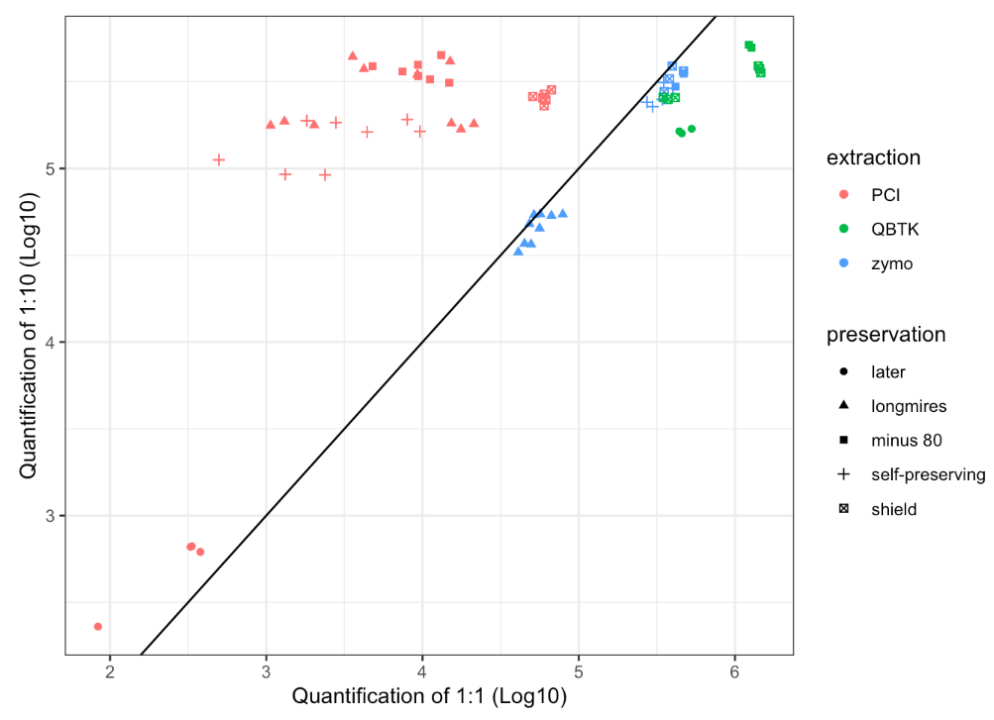
Module 1 data recap
Preservation and extraction method
Preservation
-80
Self preserving
Longmires
RNAlater
DNA/RNA Shield
Extraction
Phenol chloroform
Qiagen Blood and Tissue Kit
Zymo Mini Prep Kit
The IPC says PC samples aren’t inhibited, but their 1:1 quant is underestimated vs. 1:10 quant

Slide 19
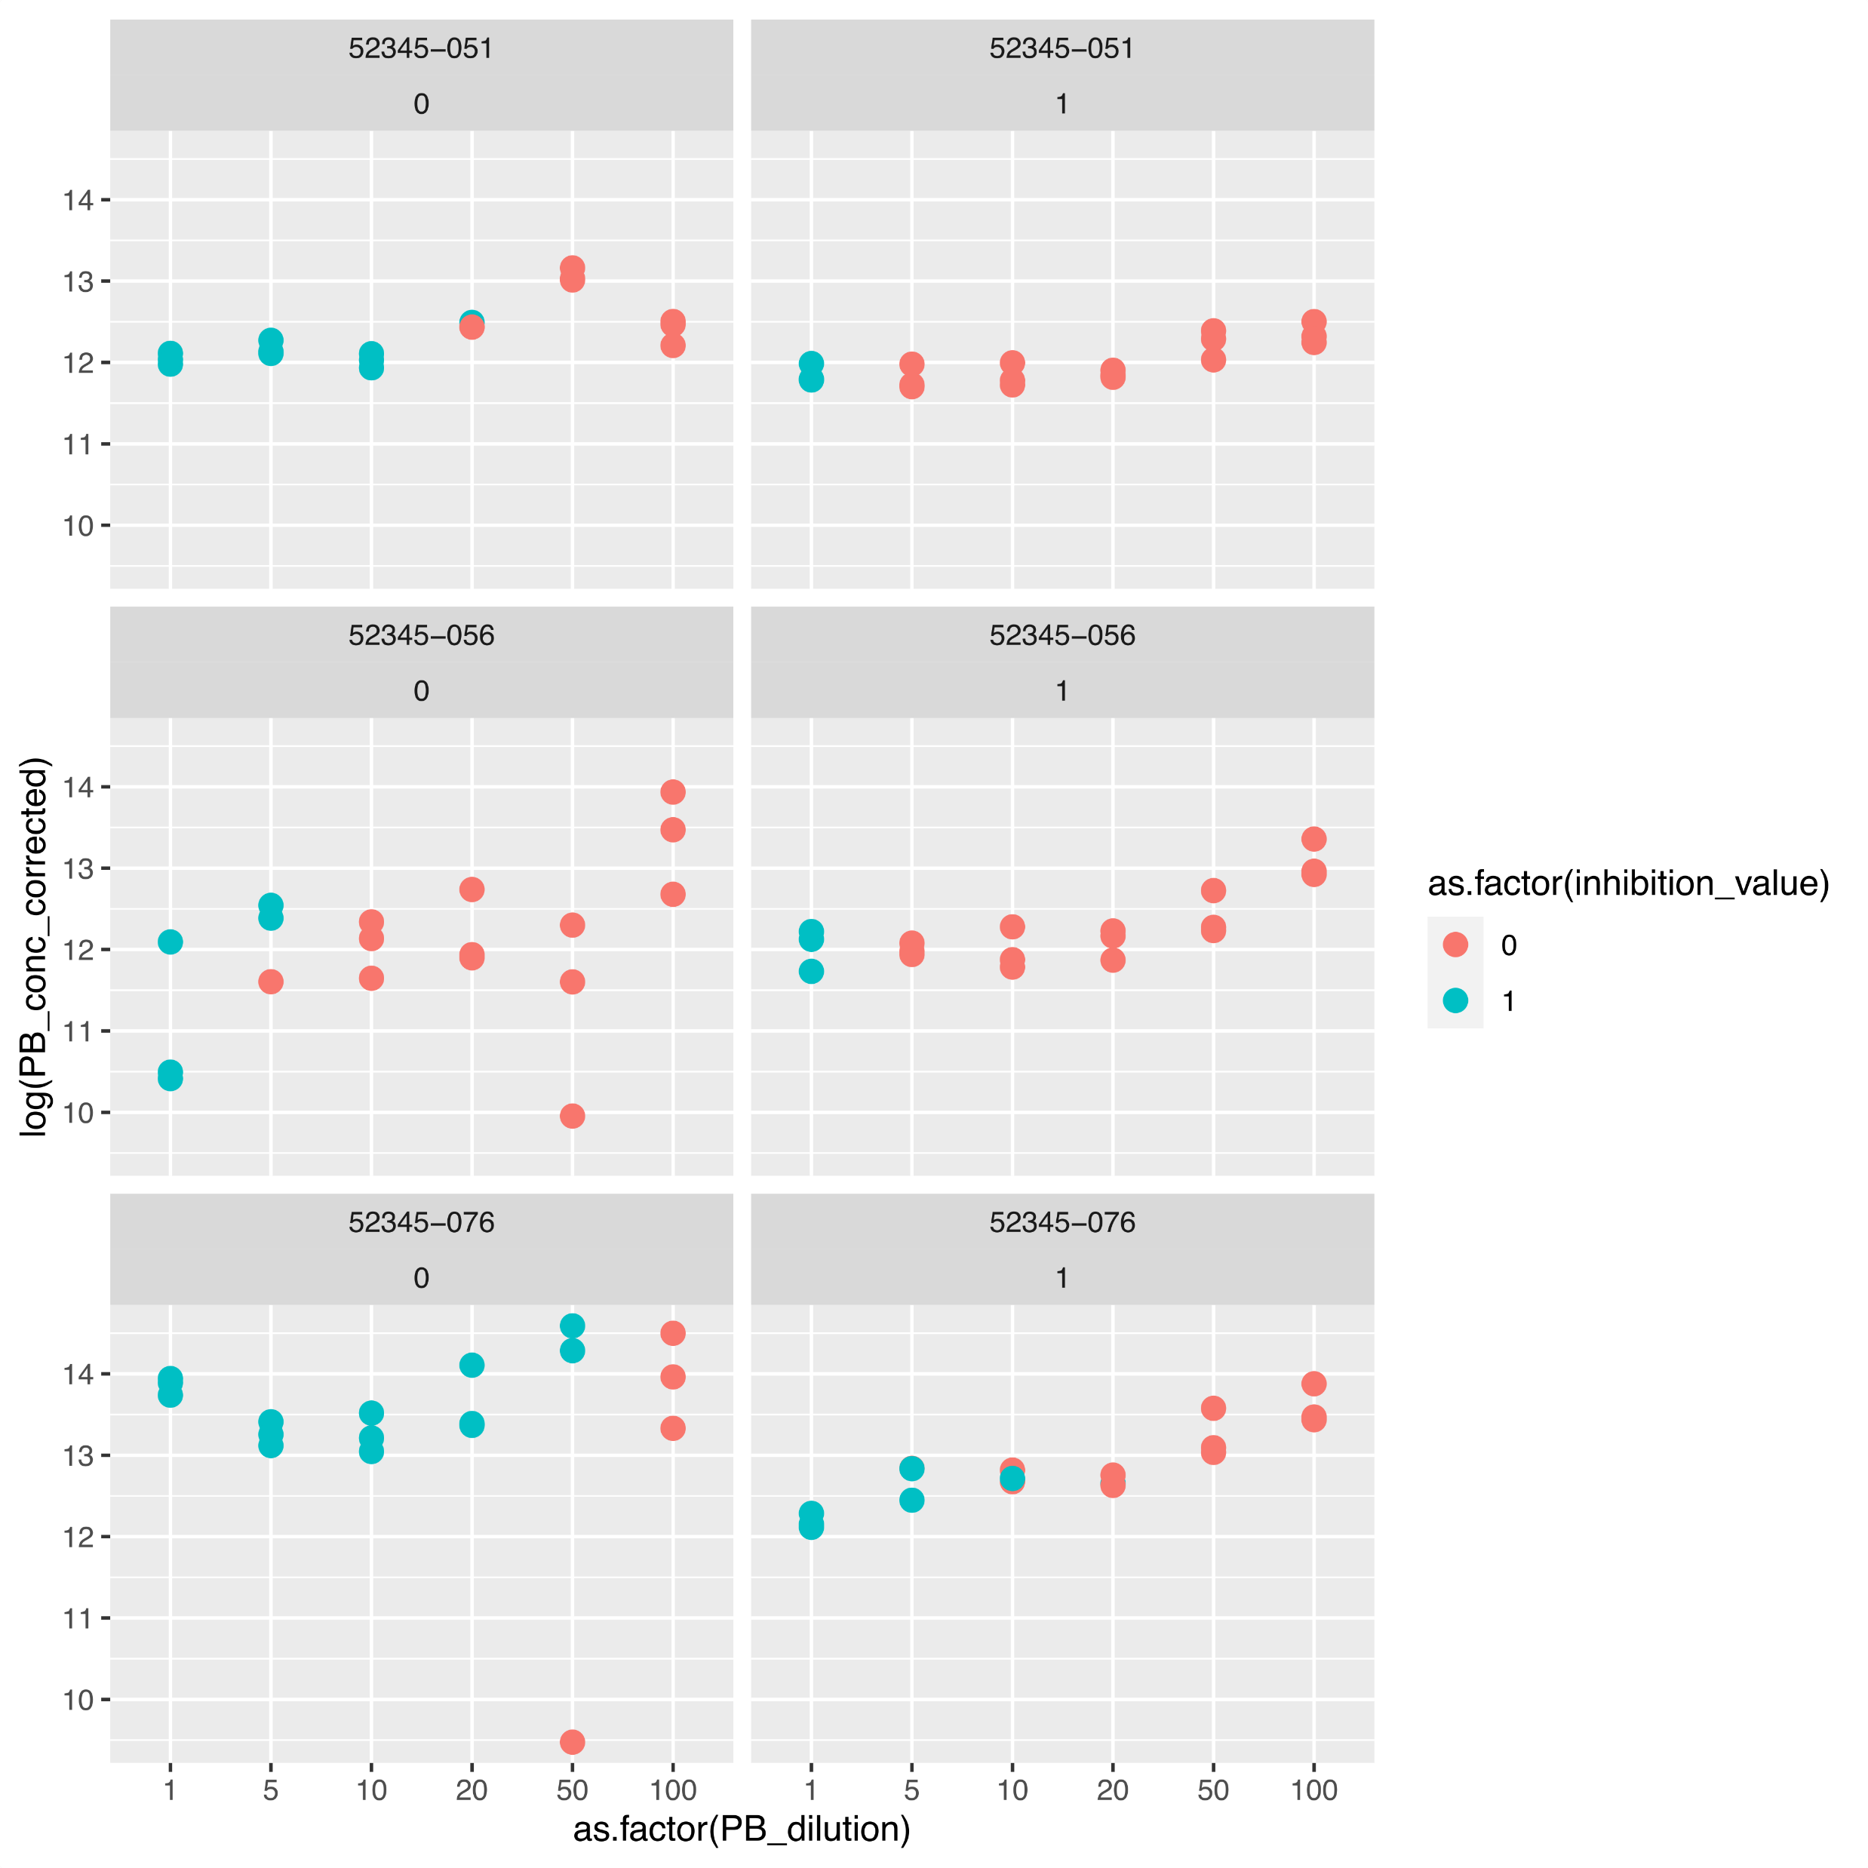
SR
Self-preserv
Zymo
SR
Self-preserv
QBTK
SR
Shield
QBTK

Slide 20
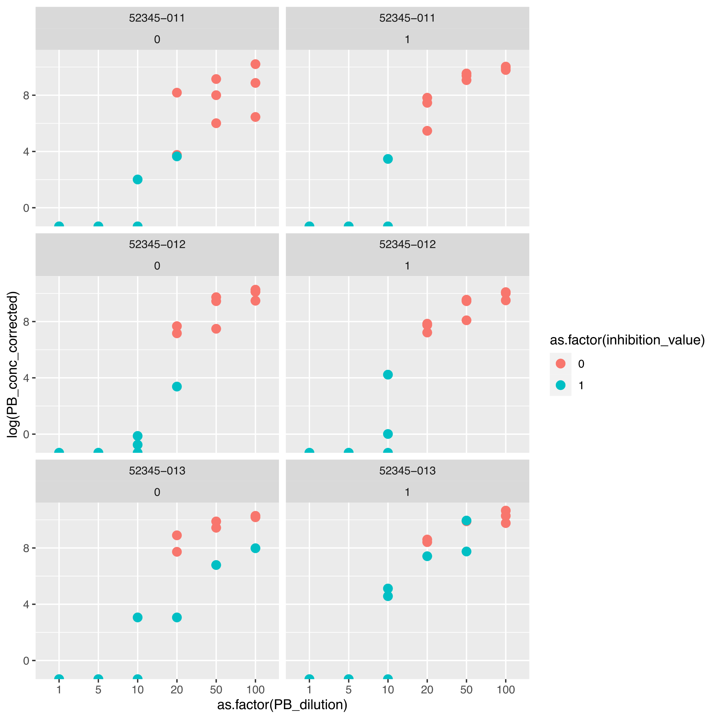
Bottle
Longmires
PC
Bottle
Longmires
PC
Bottle
Longmires
PC

Slide 21
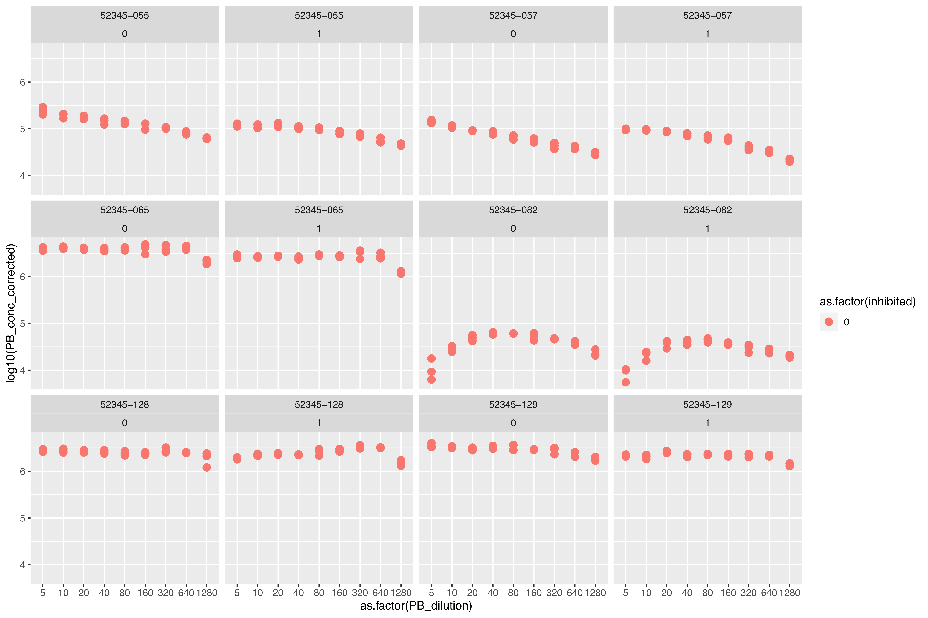
055, 057:
SR
Self-preserv
QBTK
082:
Bottle
Longmires
PC
065:
SR
-80
QBTK
128, 129:
SR
later
QBTK

Slide 22
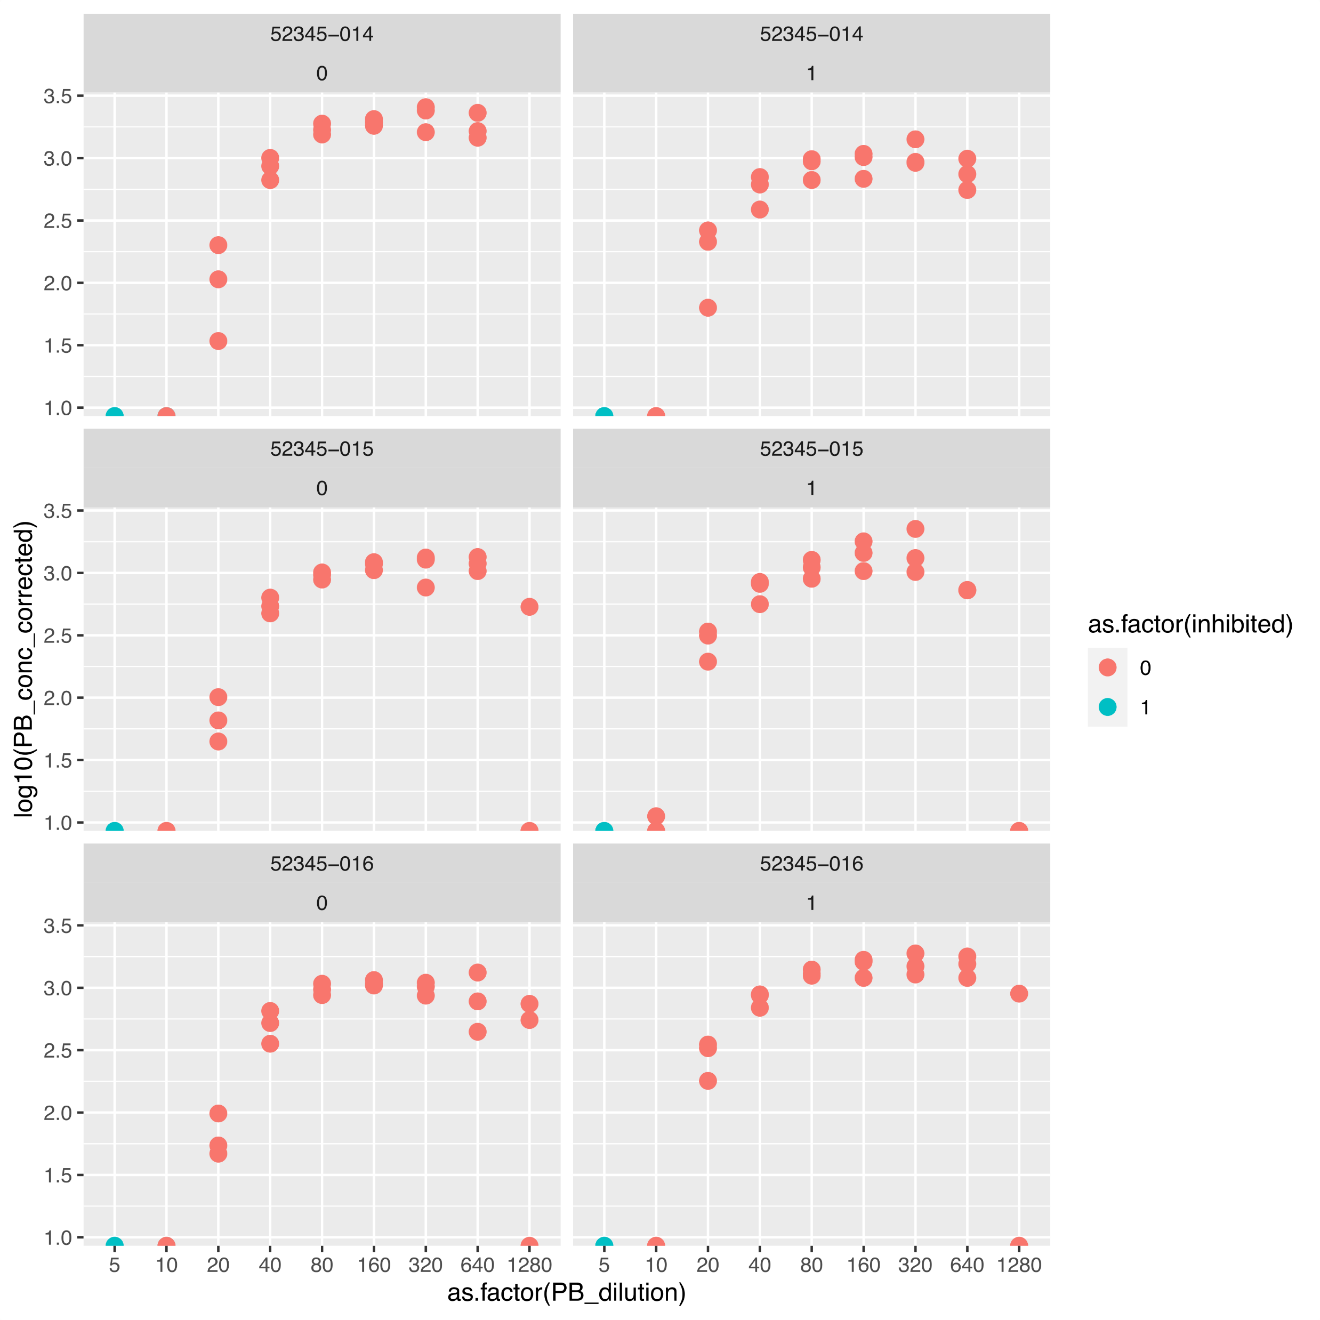
Bottle
Longmires
PC
Bottle
Longmires
PC
Bottle
Longmires
PC

Slide 23
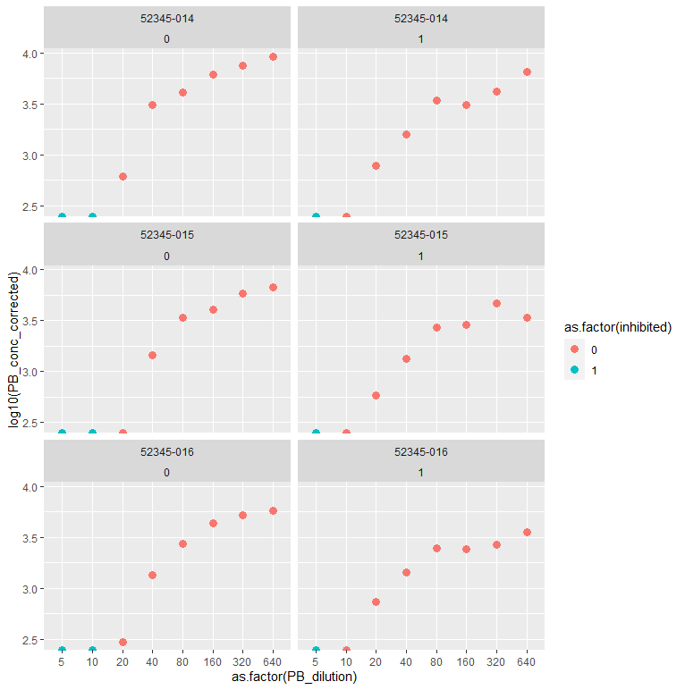

Slide 24
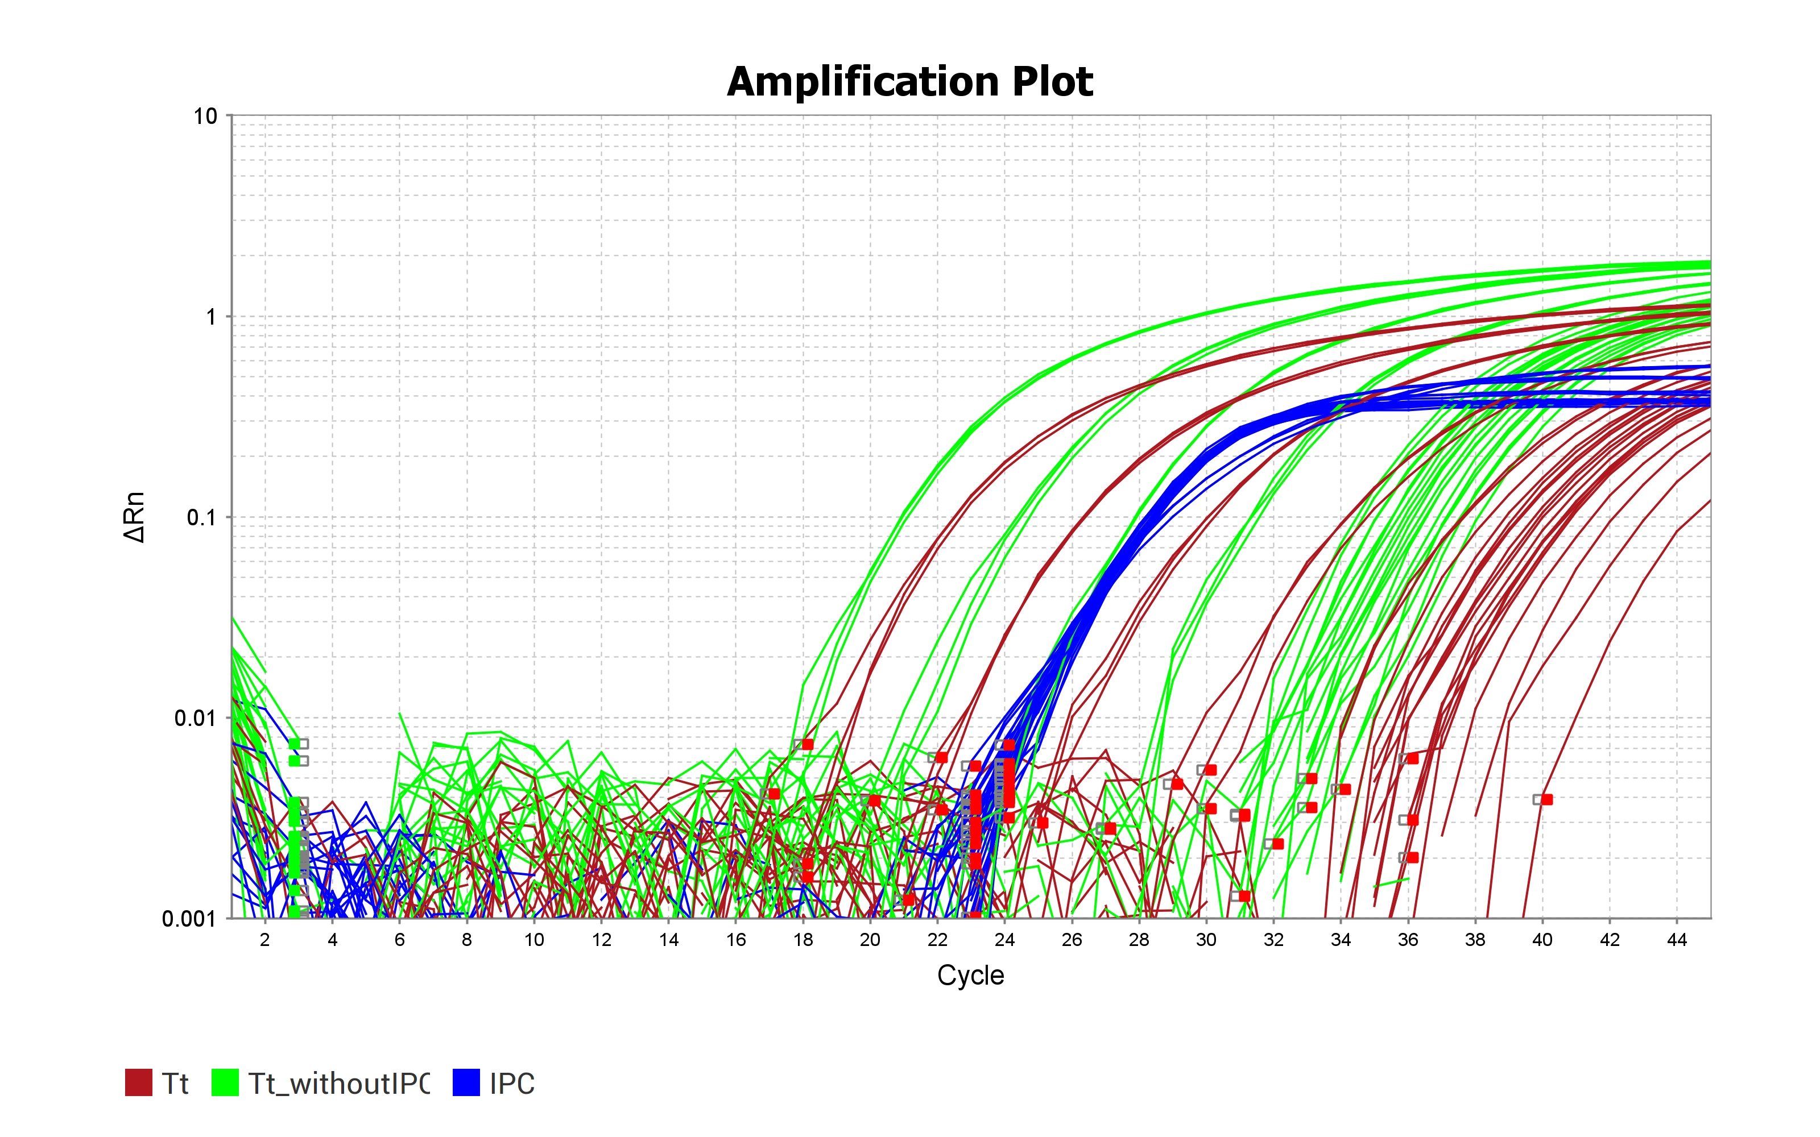

Slide 25
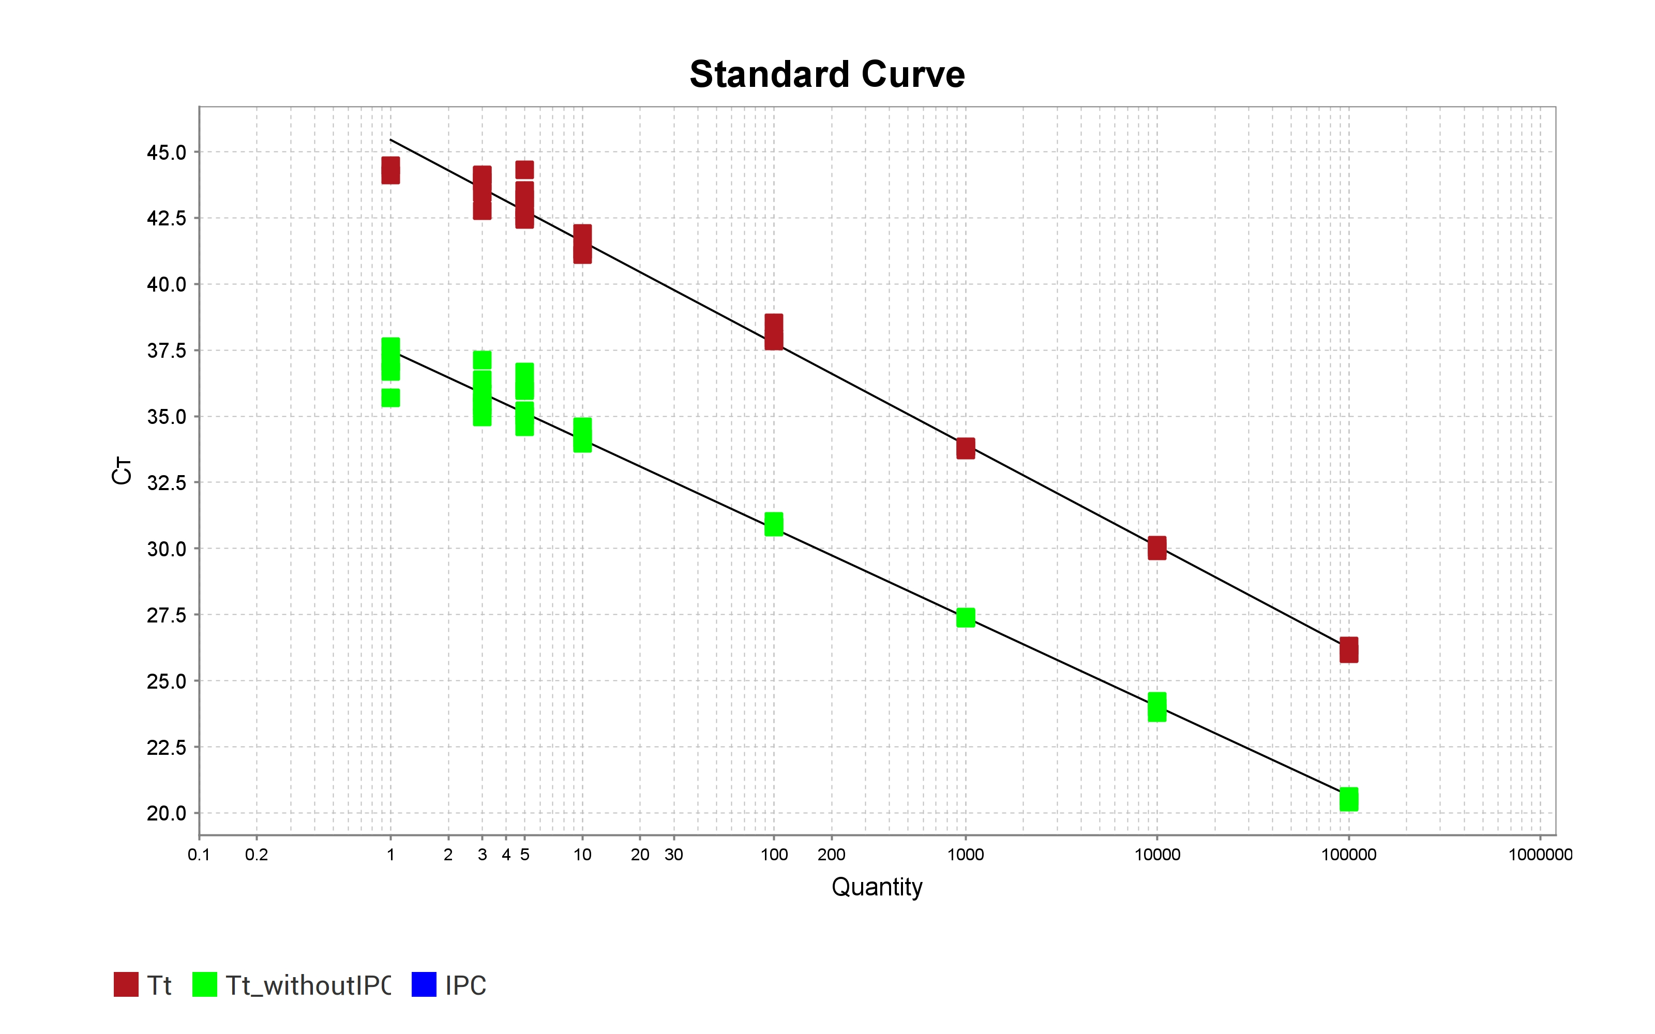

Slide 26
qPCR expectations – low target
Not cleaned
Cleaned to remove inhibitors
6
5
4
3
2
1
0
6
5
4
3
2
1
0
Log copies of dolphin DNA
Log copies of dolphin DNA
1 1E-1 1E-2 1E-3 1E-4 1E-5 1E-6
Dilution
1 1E-1 1E-2 1E-3 1E-4 1E-5 1E-6
Dilution

Slide 27
ddPCR expectations – low target
Not cleaned
Cleaned to remove inhibitors
6
5
4
3
2
1
0
6
5
4
3
2
1
0
Log copies of dolphin DNA
Log copies of dolphin DNA
1 1E-1 1E-2 1E-3 1E-4 1E-5 1E-6
Dilution
1 1E-1 1E-2 1E-3 1E-4 1E-5 1E-6
Dilution

Slide 28
Metabarcoding expectations?? – low target
Not cleaned
Cleaned to remove inhibitors
6
5
4
3
2
1
0
6
5
4
3
2
1
0
Log copies of dolphin DNA
Log copies of dolphin DNA
1 1E-1 1E-2 1E-3 1E-4 1E-5 1E-6
Dilution
1 1E-1 1E-2 1E-3 1E-4 1E-5 1E-6
Dilution

